Slide 1
Email Automation
Raphael Chin
Privileged & Confidential

Slide 2
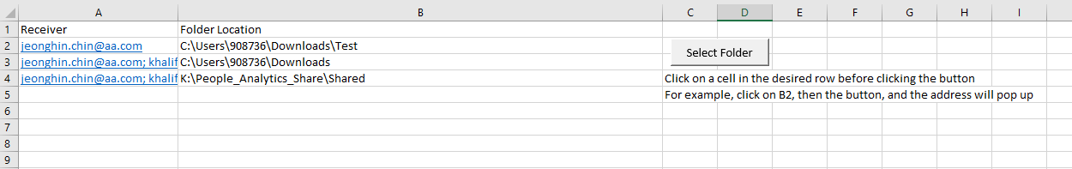
Demo
Footnotes should be aligned to bottom of the screen, with 12pt font

Slide 3
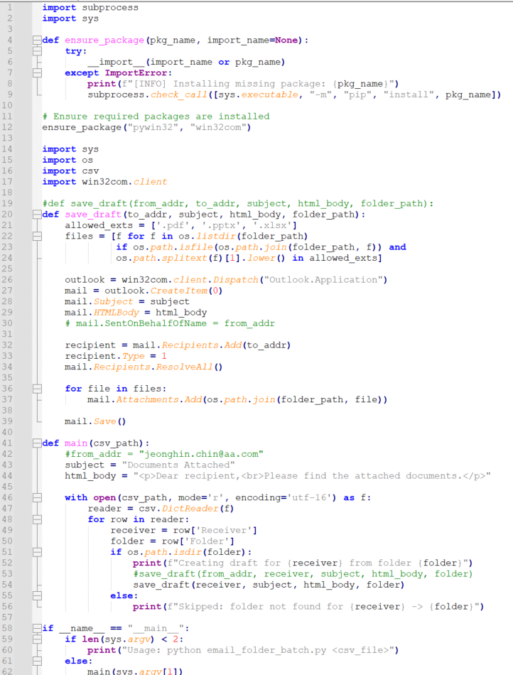
Logic - Python
Ensures that all the libraries required to run the code is present
Ensures only PDF, PowerPoint, and Excel files are chosen from the folder
This section fills up the email and attach the files

Slide 4
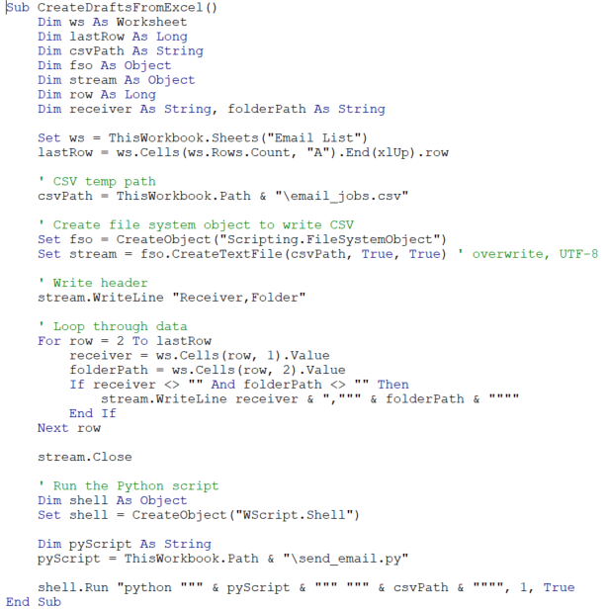
Logic - VBA
Creates csv file with the email address of the receivers
Calls Command Prompt to run Python

Slide 5
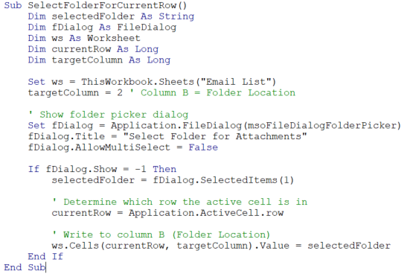
Logic - VBA
Allows user to pick folder using folder picker dialog
Fills up the last active cell

Slide 6
Next Steps
Migration to VBA, so that people without Python can run this.

